Slide 1
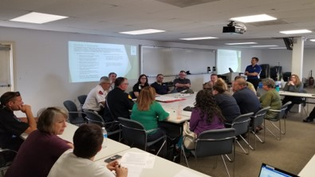
Exercises:
Tabletops and Beyond

Slide 2
Why Exercise?

Slide 3
Who? What? When? How Many?
Notes:
Let me actually re-order:
WHAT:
What type or types of exercises are you doing?
Ttx, Functional, FS
What are you exercising? A plan? Capability gaps that keep coming up in AARs? Following a planned schedule (IPP) or do unexpected incidents (tornado in Kitsap county) or leadership intent lead to changes?
HOW MANY:
How many exercises do you hold in a calendar/fiscal year? Do you want to do more?
WHO:
Exercise Design: Do you have an exercise planning team? Who is on your team? Any LEPC members? Are you the team?
Participation: Ask about participation. Hard to get participants? Harder for functional or fs? Also, support (evaluators/controllers).
What about policy-makers or electeds – do they participate in exercises? Do you ever hold exercises just for them?
As for ideas that have gotten more participation?

Slide 4
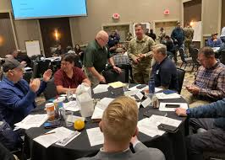
Tabletops, Tabletops and More Tabletops!
Most common type of exercise
Many obvious (and not-so-obvious) benefits
Many resources available
Evergreen Spill TTX, October 8, 2023
Notes:
Does anyone NOT use ttx?
BENEFITS:
OBVIOUS -
Ask first:
Cost less
Lower stress environment
Enhances general awareness of plans, policies, procedures
Enhances roles and responsibilities
Get used to what WE do – good to see how we fit into the entire process
NOT SO OBVIOUS-
New relationships in low-stress setting (blue sky)
Resource Assessment – different that what you might think. Not only is the obvious of what we have or don’t have, but what about “is our resource operational?” Also, more than equipment. Can illustrate that there are far more duties than people to carry them out.
Great way to TRAIN your staff/members.
Many shortfalls noted also become a continuity of operations concern
Any others?
Anyone tired of ttxs? Need new ideas?

Slide 5
Tabletop Resources
PrepToolkit
CISA Tabletop Exercise Packages (CTEP)
Other LEPCs
TTX Library (coming soon!)
LINKS:
PrepToolkit
CTEP

Slide 6
What Else? For LEPC Engagement Or….?
Games
Review plan updates/SOPs
Senior Officials/Policymaker
Drills
Evacuation drills?
Shelter-in-Place?

Slide 7
Resources and Examples
Lab X: Extreme Event Game
Free game material
12-48 players
1 hour

Slide 8
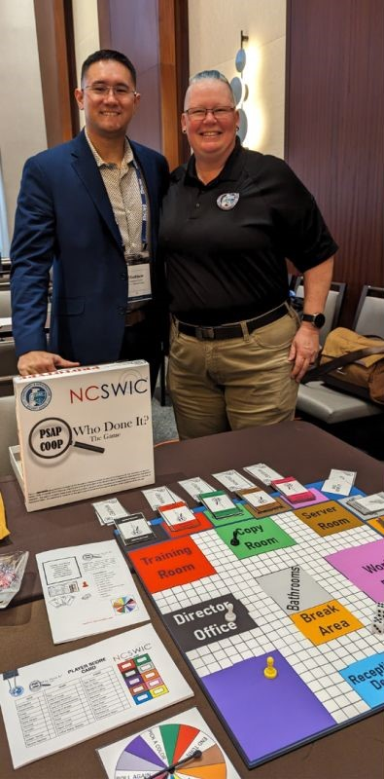
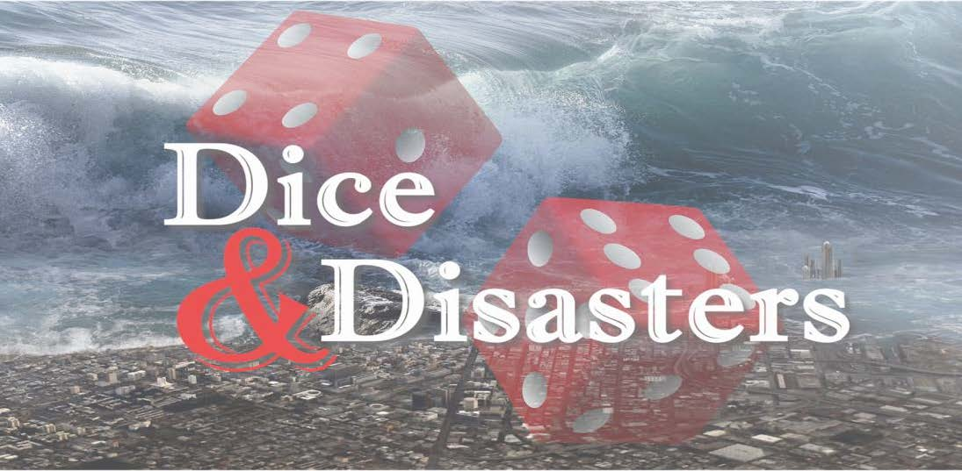
Games Resources and Examples
LabX: Extreme Event
Disasterville – National CERT Association (free of charge)
Dice & Disasters – WA EMD Hazards & Outreach Team
Laura Goudrea, CISA - NCSWIC
Notes:
Extreme Event: presented by the National Academy of Sciences. It draws on recommendations in the 2012 National Academies consensus study report on disaster resilience. Players work together to make decisions and solve problems during an engaging, fast-paced disaster simulation. There are 3 scenarios to choose from: earthquake, hurricane, or flood. You can download the free kit, which includes the facilitator guide, digital game portal rules & resource guide, sound effects, presentations, game scoring rubric, full game kit (nametags, sector cards, etc). Or there is a digital game portal which requires 7 computers/tablets and Wifi.
They also have a Facilitator Certification Program if you want to facilitate this for others.
Disasterville is an interactive hands-on activity that is useful for CERT teams, Medical Reserve Corps, Voluntary Organizations Active in Disasters (VOAD), as well as local officials, Emergency Managers, professional responders, and the general public. It’s designed as a table-top activity simulating a town set up with small buildings & figurine. The toolkit has markers to set up a disaster scene of your choosing, including infrastructure damages, structure damages, and victim conditions. It also incorporates additional components such as an EOC.
Dice & Disasters – This is a preparedness game created by our own Hazards & Outreach Team! East to play and available on our emergency management website
NCSWIC – Laura had been with FEMA Region X, the went on to CISA and has designed multiple games, one of which is NCSWIC, which takes its inspiration from the game of “Clue”. However, instead of responding to a known disaster and executing their COOP plans, the gameplay works backward and teams must test different elements of a COOP to determine what caused the incident. This game isn’t available yet, but really exciting to see what is out there.

Slide 9
Additional Resources
FEMA’s National Exercise Program (NEP)
IEMC – Integrated Emergency Management Course
National Exercise Program
IEMC
Notes:
NEP – support tailored to the needs of the jurisdiction. CWU is having a Mass Casualty exercise June 12th and is being supported by FEMA Region X (example). No associated cost. Application once a year (in March). Webinar online for more information.
IEMC - four-day, exercise-based training activity for Emergency Operations Center personnel to practice simulated, but realistic, crisis situations, within a structured learning environment. The jurisdiction selects the hazards and core capabilities it wishes to simulate in classroom and exercise components of the course. The design will reflect the jurisdiction's specific hazards and organizational structure included in its emergency plans.
There is an application process, usually due by the end of year.

Slide 11
From This…..
To This….

